Slide 1
Disaster Management, Communities and Climate Change: the Role of ICTs
2010 ICT4D Conference
London, UK
13th December, 2010
Nonita T Yap, PhD., MES
Professor
School of Environmental Design and Rural Development
University of Guelph
Guelph, Ontario Canada

Slide 2
Overview
Disaster and development link
Context for ICT use in developing country disasters
ICT capabilities necessary for improving DM/Factors contributing to effective ICT use in DM
Information and communication needs in DM in developing countries – examples of ICT applications
Strategic recommendations
Areas for future research
2

Slide 3
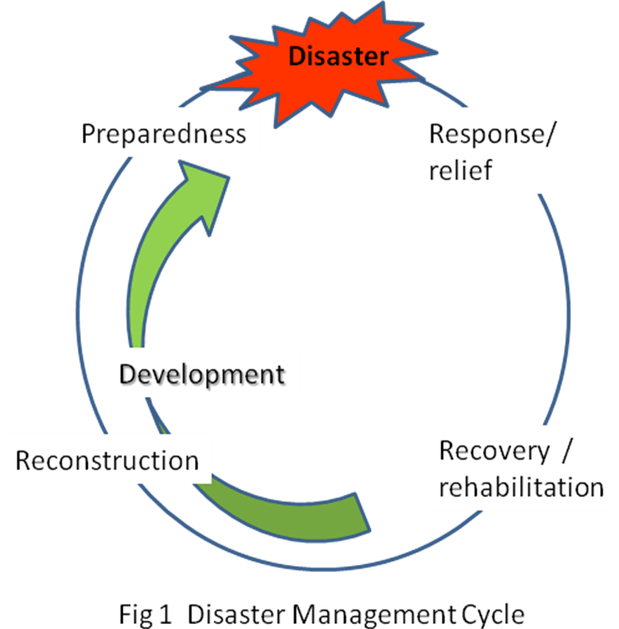
Disaster and development
No consensus
what is a disaster
what are the different disaster phases
Agreement
disaster management is best conceptualised as a cycle
management phases form a continuum
2 types of natural disasters
slow onset
rapid onset

Slide 4
Developing Country Context for ICT use in DM
Data - needs to be acquired, processed and analysed under severe time pressure
Data and information - from multiple sources with different standards -> interoperability
Involvement of different agencies with slightly different mandates –> coordination
Disaster (rapid onset) situation – fluid, dynamic
Barriers to information access and response options – isolation, culture, religious, legal, organisational, technological, infrastructure
Data users are frequently without adequate training and working under difficult conditions

Slide 5
Factors contributing to effective ICT use in DM (2007) | ICT capabilities needed for improving DM (US NRC 2007)
Adequate penetration of broadband internet | More robust, interoperable, and priority-sensitive ICT
Intra- and inter-agency coordination | Improved situational awareness and a common operational picture
Competence in data analysis, interpretation, integration, maintenance and repair of hardware | Improved decision support and resource tracking and allocation
Common technical and operating standards on access to ICT | Greater organisational agility
Interoperability of devices, equipment, networks, and systems | Better public engagement
Sustained advance preparedness | Enhanced infrastructure survivability and continuity of social function

Slide 6
Information and communication needs during disasters
Effective delivery of understandable, actionable disaster alerts to the ‘last mile’
Dissemination of hazard information to as many as possible as quickly as possible
Collection, processing, integration of data from multiple sources
Management continuity when telecom infrastructure and links are compromised
Intra- and inter-agency coordination
Transparent and accountable resource allocation and use

Slide 7
Effective delivery of EW to the ‘last mile’
Dissemination to as many as possible as quickly as possible
Collection, processing & integration of data from multiple sources
Management continuity when telecom infrastructure and links are compromised
Intra- and inter-agency coordination
Transparent and accountable resource allocation and use
Radio, television, phone (fixed and mobile), CB
Radio, television, phone (fixed and mobile), CB, Web 2.0
GIS cum remote sensing (EOS, UAV, GPS)
Wireless Internet, satellite-based communication
CIS+ remote sensing, GPS,
Web 2.0, USHAHIDI, DUMBO, SAHANA, DAD
Need
ICT tools

Slide 8
STRATEGIC RECOMMENDATIONS
Continuity: anticipate the unexpected, prepare for the worst
Effectiveness: know the context
Sustainability: build local capacity
Synergies: learn from, share and work with others
Systems design: technology & management
flexible, composable, interoperable
monitor, evaluate learn, adjust
Put people at the centre, not the technology: define the problem before the solution

Slide 9
Areas for future research
Technology development
Reliable radio communication inside rubble, underground
Data ‘mining’ across diverse information sources
Human – technology interface
Interrelationship between technology and organisational models
Interrelationship between technology and policy
Systematic assessment of impacts of ICTs on quality and effectiveness of DM practices

