Slide 1

ICTs for Climate Change Adaptive Capacity Development
By:
Laxmi Prasad Pant, PhD
lpant@uoguelph.ca
School of Environmental Design and Rural Development, University of Guelph, Guelph, Ontario, Canada

Slide 2
Overview
A need to develop climate change adaptive capacity of vulnerable communities, e.g., National Adaptation Programme of Action (NAPA).
One source of adaptive capacity is expert and local knowledge integration, and ICTs can facilitate this process.
But ICTs, the proposed solutions, have their own problems due to the digital vicious cycle, digital exclusion leads to social exclusion, and vice versa.

Slide 3
Climate Change: A Complex Problem
Climate change
Snowden. and Boone (2007)

Slide 4
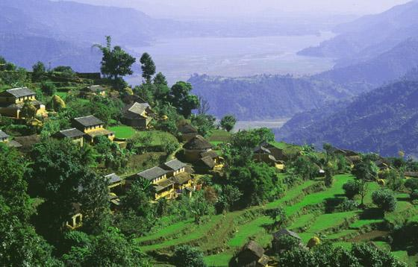
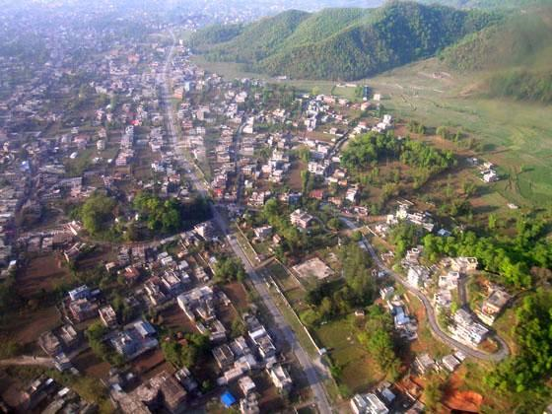
Complex Systems: Self-Organising Systems
Interacting elements.
Non-linear interactions.
Emergent properties, 2+2 ≠ 4.
Self-organizing systems.

Slide 5
Climate Change Adaptation Strategies: Deliberate and Emergent

Slide 6
Two Main Sources of Climate Change Adaptive Capacity
Loop 2: Transformational capacity
Breaking the digital vicious cycle
Bridging the digital divide
Loop 1: informational capacity

Slide 7
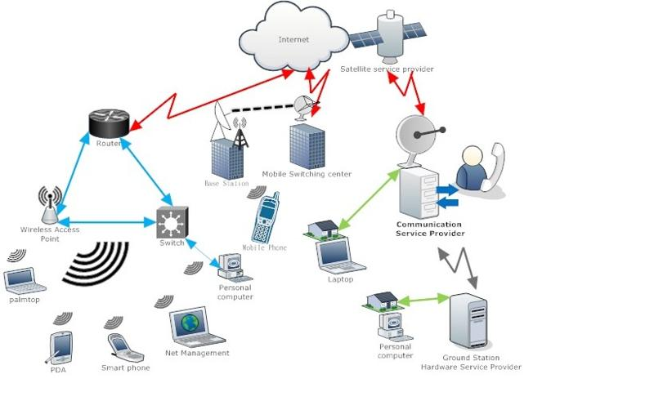
Emerging Archetypes of ICT Infrastructure
1. Advanced Internet .
2. Ordinary mobile phone.
3. Remote Internet Access, such as Telecentres.
4. Mobile phone + telecentre.
5. Emerging ICTs + community radio, face-to-face interaction.

Slide 8



Case Studies
Ubiquitous use
Flood Warning Systems.
Weather forecasting, fishing zones, market information, cultivation practices.
Short messaging services (SMS).
Experimental use
Food security monitoring.
Disease surveillance.
Household survey about insecticide treated bednets.
Luxurious use; not even experimental
Multimedia messaging service (MMS).
Based on eight projects across nine countries in Africa, South Asia and Latin America.

Slide 9
Examples of Deliberate and Emergent Adaptation Strategy
 | Intended | Unintended
Anticipatory | Deliberate strategy, e.g., early warning systems. Effective in simple and complicated systems
Autonomous |  | Emergent strategy, e.g., agriculture and health information systems. Effective in complex adaptive systems

Slide 10
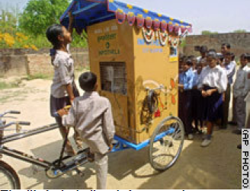
Failed Attempts to Transform Telecentres
Integrated services, e.g., digital literacy, job search, tutorial, and public meeting venue.
Strategic locations, e.g., library and market places.
Mobile services, e.g., info-cart.
Indian Institute of Technology,
Kanpur, Lucknow

Slide 11
Concluding Remarks
The digital divide is undermining the use of ICTs for adaptive capacity development.
Telecentre models are failed attempts to bridge the digital divide; a technological solution would be to combine with ordinary mobile phones.
The underlying problems are not just technological: digital vicious cycle.
Further research on how ICTs are being prioritized in the National Adaption Programme of Action (NAPA).

Slide 12
Thank you!

